Slide 1


Slide 2

Brief Introduction
Tanuj Nigam is a data scientist with 5+ years of professional experience in the area of data science. He is well versed with advance analytics tools and technologies including Deep learning, Blockchain, MLOPS etc. Apart from his work he is a visiting faculty at multiple data science institutes. His current interest includes use of AI/ML to build Quants based model for stock markets.
Linkedin : https://www.linkedin.com/in/tanuj-nigam-a4748375/

Slide 3
Types of Learning
With Teacher | Without Teacher
Reinforcement Learning/Active Learning | Intrinsic Motivation/ Exploration
Supervised Learning | Unsupervised Learning
Active
Passive

Slide 4
Why learn without a Teacher ?
If our goal is to create intelligent systems that can succeed at a wide variety of tasks (RL or supervised), why not just teach them those tasks directly ?
1. Targets/ Rewards can be difficult to obtain or define
2. Unsupervised learning feels more human
3. Want rapid generalization to new task and situations

Slide 5
The Cherry on the Cake
The targets for supervised learning contains far less information than the input data
RL rewards signals contains even less
Unsupervised learning gives us an essentially unlimited supply of information about the world: surely, we should exploit that ?
If intelligence was a cake, unsupervised learning would be the cake, supervised learning would be the icing on the cake, and reinforcement learning would be the cherry on the cake
-Yann LeCun

Slide 6
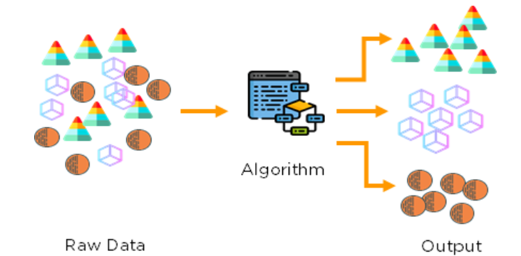
Unsupervised Learning
No labels are given to the learning algorithm, leaving it on its own to find structure in its input.
Unsupervised learning can be a goal in itself (discovering hidden patterns in data) or a means towards an end (feature learning).
Issues with Unsupervised Learning:
Unsupervised Learning is harder as compared to Supervised
Learning tasks
How do we know if results are meaningful since no answer
labels are available?
Let the expert look at the results (external evaluation)
Define an objective function on clustering (internal evaluation)

Slide 7
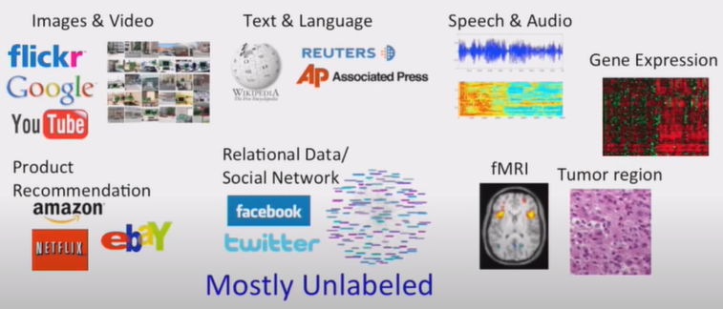
Mining for Structure
Massive Increase in both computational power and the amount of data available from web, video cameras, laboratory measurements
Develop statistical models that can discover underlying structure, cause or statistical correlation from data in unsupervised or semi supervised way
Multiple application domains

Slide 8
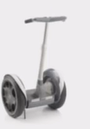




Learning Feature Representations
Input Space
Pixel 1
Learning Algorithm
Pixel 2
Pixel 1
Pixel 2
Input Space
Feature Representation
Learning Algorithm
Wheel
Handle

Slide 9

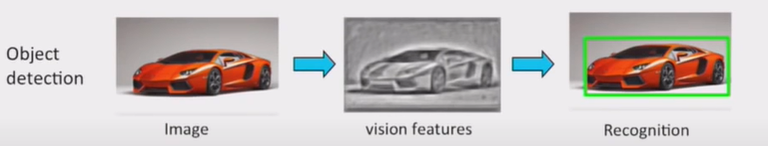
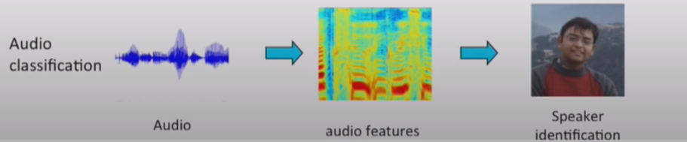
Traditional Approaches
Representation Learning :
Can we automatically Learn these representations ?

Slide 10
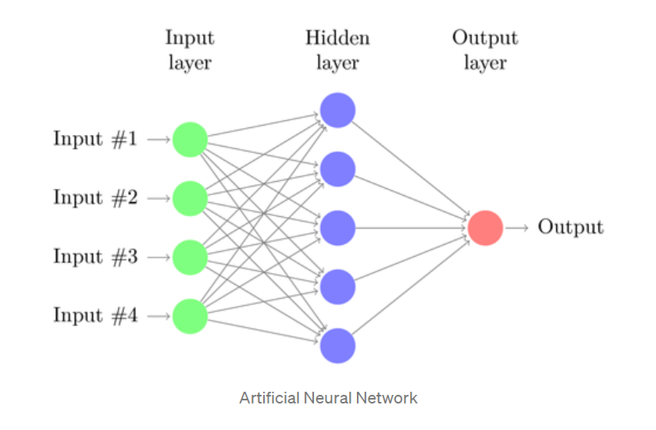
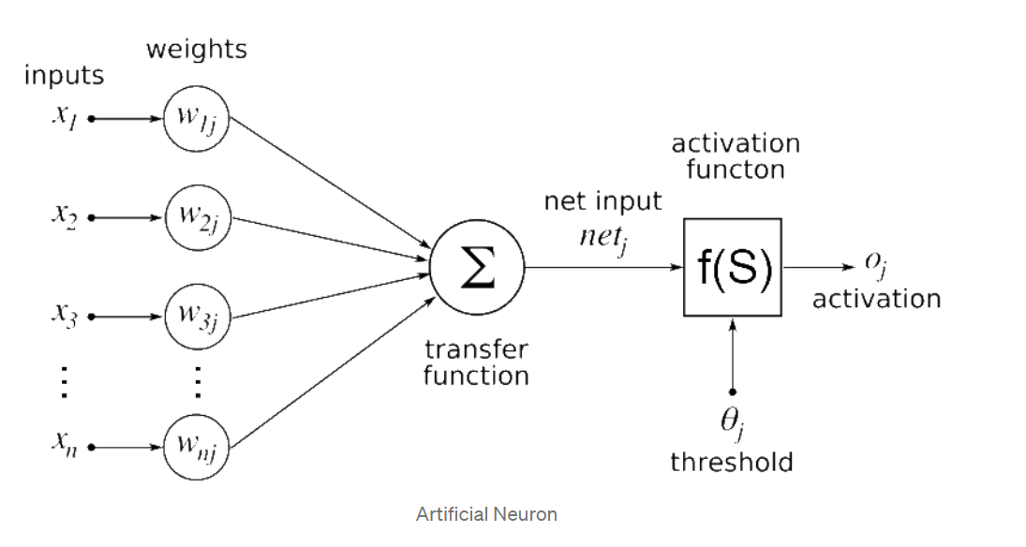
Deep Neural Network
Artificial Neural Network is a network of interconnected artificial neurons (or nodes) where each neuron represents an information processing unit.
The nodes interact with each other and share information. Each node takes input and performs some operation on it before passing it forward.
The operation is performed by what is called an Activation function (non-linearity). It converts the input into output which can be then used as input for other nodes.
In a nutshell, an Artificial neuron takes input from other nodes and applies the activation function to the weighted sum of input (Transfer function) and then passes the output.

Slide 11
Unsupervised Deep Learning Models
Unsupervised Learning
Non –Probabilistic Models
Sparse Code
Autoencoders
Others (e.g K-means)
Probabilistic Models
(Generative)
Tractable Models
Fully observed Belief Nets
NADE
PixelRNN
Non- Tractable Models
Boltzmann Machine
Variational Autoencoders
Many Others.
Generative Adversarial Network
Transformers XL
Explicit Density p(x)
Implicit Density

Slide 12
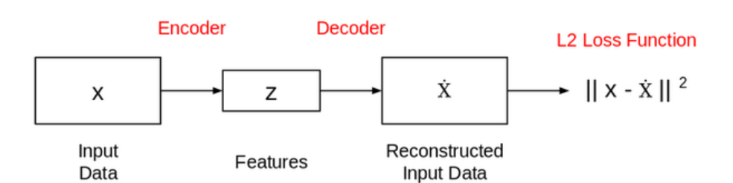
Autoencoders
Autoencoders are essentially neural network architectures built with the objective of learning the lower-dimensional feature representations of the input data.
It is comprised of two connected networks – encoder and decoder
The aim of an encoder is to take an input (x) and produce a feature map (z)
This network is trained in such a way that the features (z) can be used to reconstruct the original input data (x). If the output (Ẋ) is different from the input (x), the loss penalizes it and helps to reconstruct the input data.

Slide 13
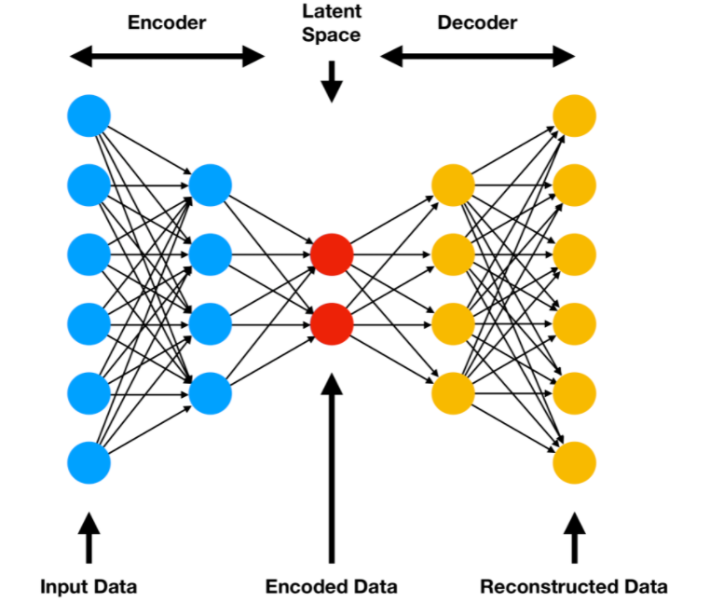
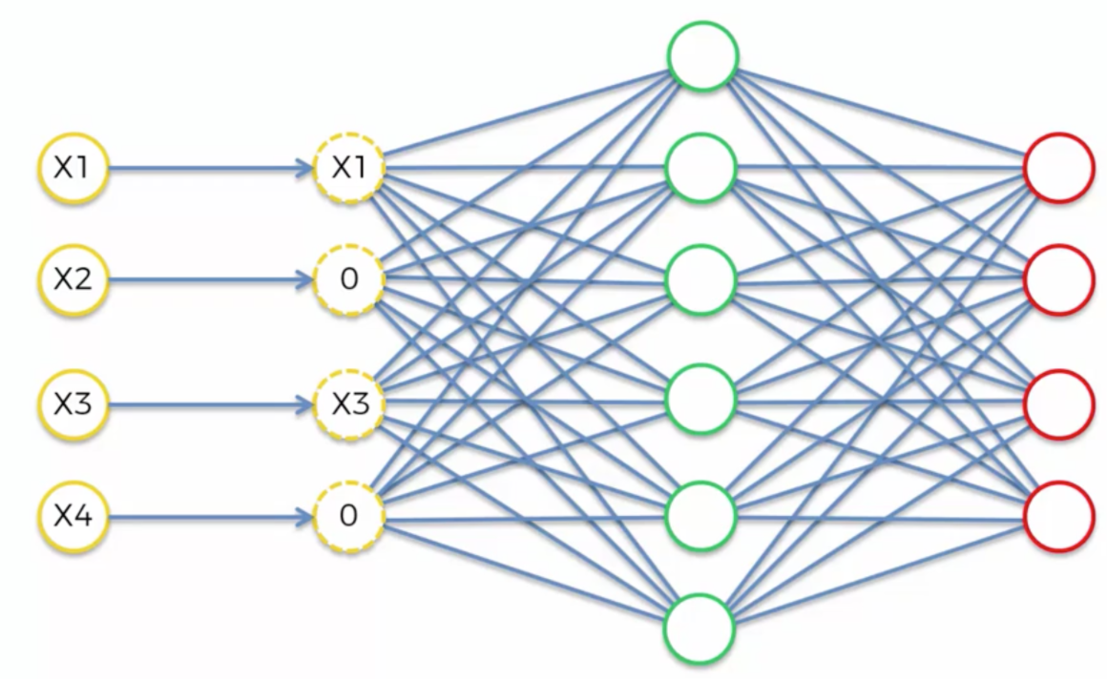
Types of Autoencoders
Simple Autoencoder : e.g Image Reconstruction
Sparse Autoencoder: e.g. Image Compression
Add a sparsity constraint on the hidden representations by applying regularization so that fewer
units get activated at a given time to give us an optimal reconstruction.
Denoising Autoencoder: e.g. Image Denoising
Denoising Autoencoders solve the reconstruction error problem by corrupting the
data on purpose by randomly turning some of the input values to zero.

Slide 14
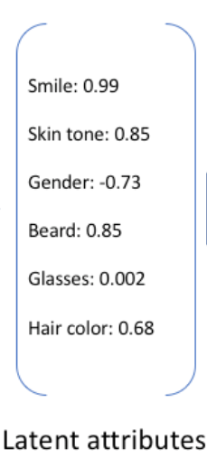

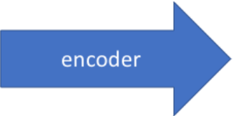
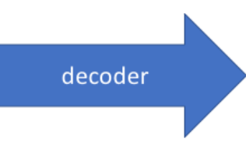
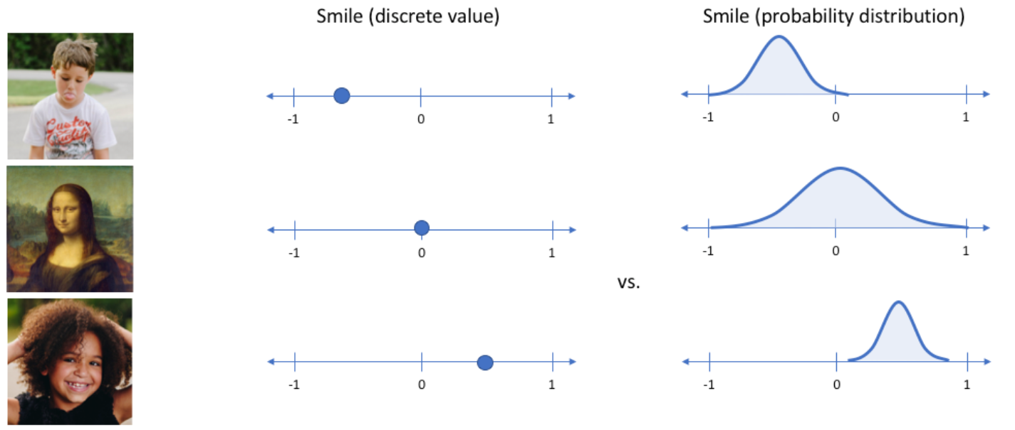
Types of Autoencoders
Variational Autoencoders : Image Generation
An Ideal autoencoder will learn descriptive attributes like such as skin color, whether or not the person is wearing glasses, etc. in an attempt to describe an observation in some compressed representation (Feature Representation)
However, we may prefer to represent each latent attribute(Feature Representation) as a range of possible values. Using a VAE, we can describe latent attributes in probabilistic terms.

Slide 15
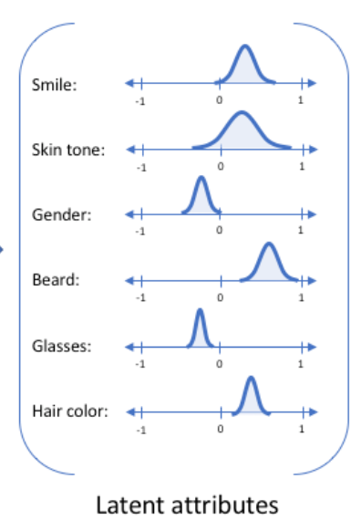
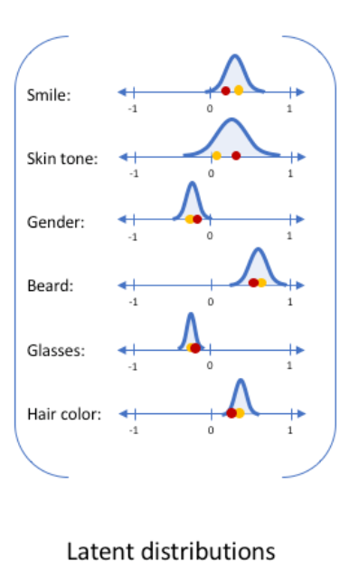
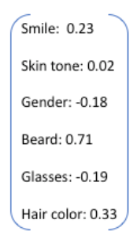
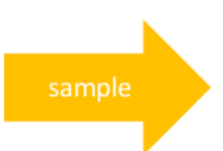
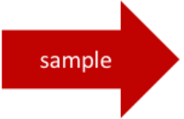
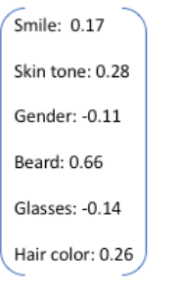
Types of Autoencoders
We'll now represent each latent attribute for a given input as a probability distribution.
When decoding from the latent state, we'll randomly sample from each latent state distribution to generate a vector as input for our decoder model
Generative model
Recognition model

Slide 16
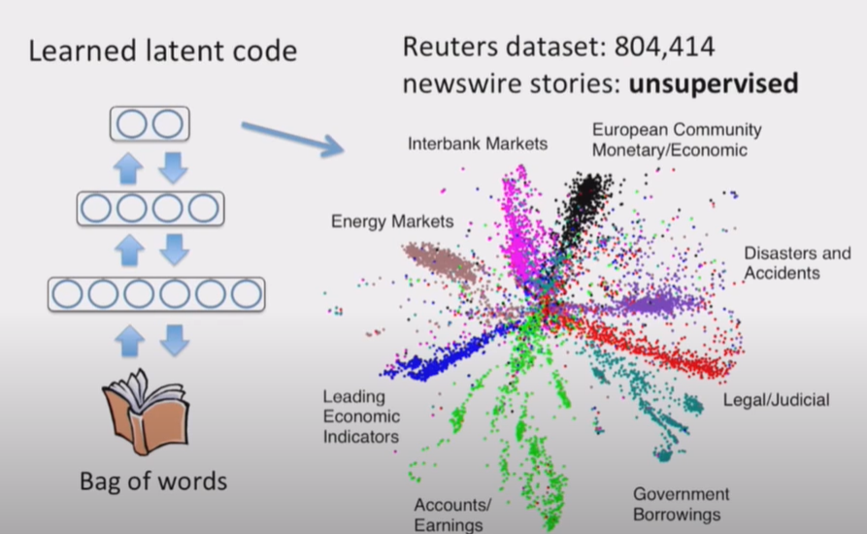
Deep Autoencoder in Text

